Slide 1

Welcome

Slide 2
Note for the honourable teachers:
The subject teachers are requested to read the notes given below the slides.
Notes are given bellow the slide no. 5, 8, 11, 12, 13, 14, 15, 16 and 17 .

Slide 3
Note for the honourable teachers:
This content may be too long as lesson’s activities are many. If it is too long, it can be taken in two periods. From slide no 14 – 18 can be taken in another period in another day.

Slide 4
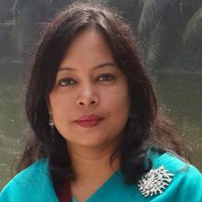
INTRODUCTION
ROUFUN NAHAR
ASSISTANT TEACHER ( ENGLISH)
MAZIDA GOVT. HIGH SCHOOL
TONGI, GAZIPUR
CLASS: SEVEN
SUBJECT: ENGLISH FIRST PAPER

Slide 5
Let’s watch a video clip.
Question: What have you seen in the video?
Notes:
First the students will see the video. Then the teacher can ask the question to the whole class. SS ca raise their hands. Teacher can ask 2/3 students to narrate the video.

Slide 6
Today our topic
What can we do?
UNIT: NINE
LESSON: 6

Slide 7
LEARNING OUTCOMES OF THE LESSON
By the end of the lesson the students will be able to…
Talk about climate and environment.
Read and understand text.
write short guided and semi-guided sentences and passages.
Tell the meaning of some key words from inference.

Slide 8
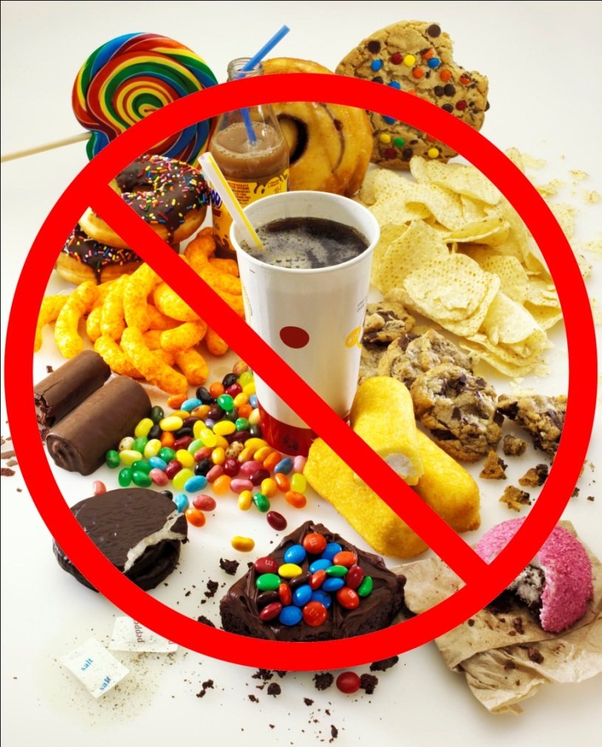
Keep off
Vocabulary
Meaning
To avoid something.
We should keep off taking junk food.
Notes:
First, the word will be shown. The SS will be asked to pronounce the word. If it is needed teacher can help. Then the picture and the sentence will be shown and asked to guess the meaning. Then the meaning will be shown. Then they will be asked to make a sentence of their own. In the same way, slide no. 9 and 10 can be conducted.

Slide 9
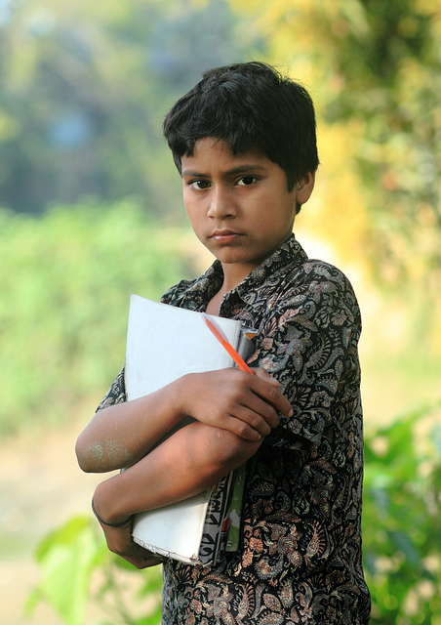
Lifestyle
Vocabulary
Meaning
the way in which a person or group lives; way of living
The boy is ready for going to school and this is his lifestyle .

Slide 10
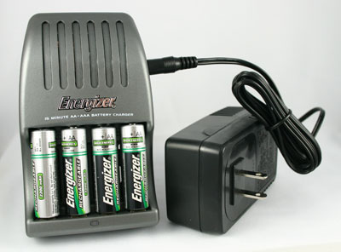
Rechargeable
Vocabulary
Meaning
capable of being recharged.
Rechargeable batteries save energy.

Slide 11
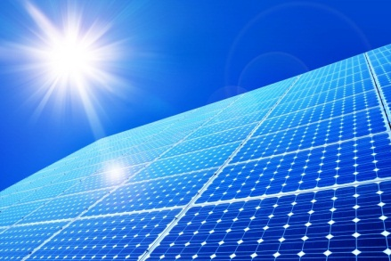
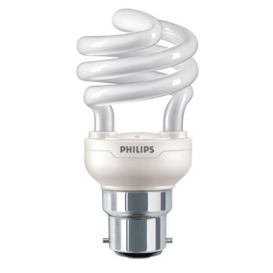
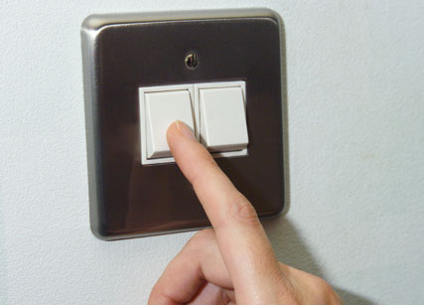
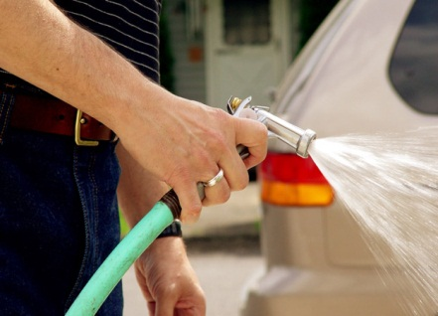
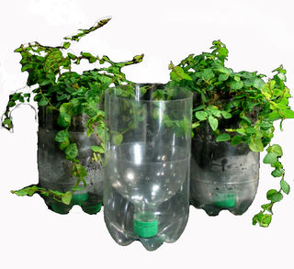
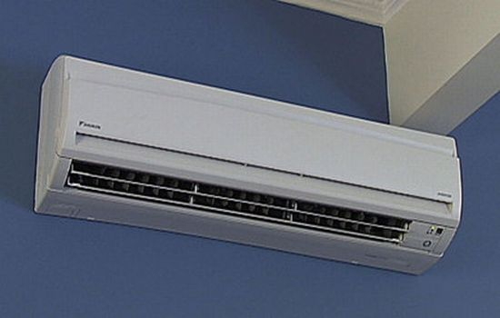
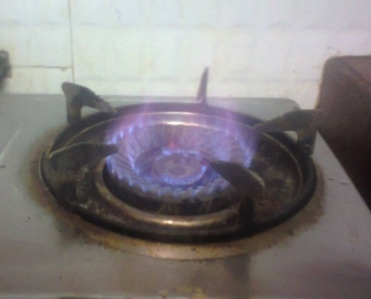
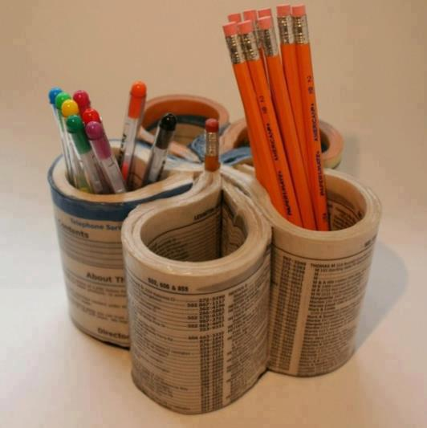
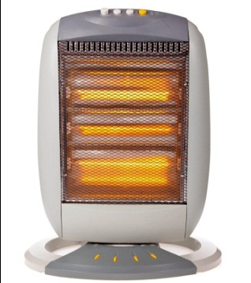
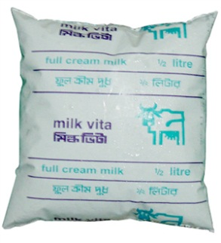
Look at the pictures.
Now match the pictures with the words from the box.
Now look at the box bellow.
1
2
3
4
Solar energy
Energy saving bulb
Turning off switch
Using hose pipe
5
6
7
8
Re-use bottles
Air-conditioner
Burning gas
Re-use papers
Dairy product Air-conditioner
Solar energy Turning off switch
Re-use bottles Burning gas
Room heater Energy saving bulb
Re-use papers Using hose pipe
9
10
Room heater
Dairy product
Notes:
This slide will help the students to understand the passage given in the text book.

Slide 12
Individual Work
Go to the textbook and read the passage from section A and write the answer of the following questions.
1. What can you often use instead of air-conditioning?
Answer
I/We can often use hand fans instead of air-conditioning?
2. How do people waste a lot of energy?
Answer
People often leave lights, heating, air-conditioning, computers, TVs and gas burners on when they do not use them. Thus, they waste a lot of energy.
3. How can you save energy?
Answer
We can save energy by turning things off when we don’t use them.
Notes:
The teacher can ask SS to go to the textbook , section A and read the passage. After reading the passage student will find out the answer from the passage. 10 minutes can be given for the task. Then the teacher can elicit answer from 4/5 students. Then teacher can show the answers.

Slide 13

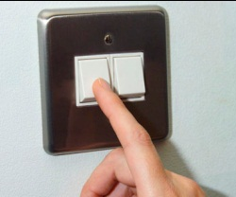

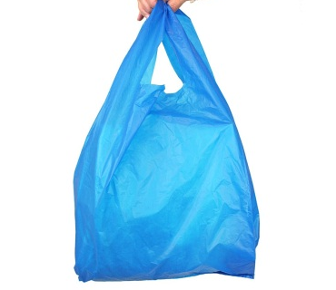
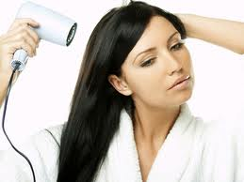
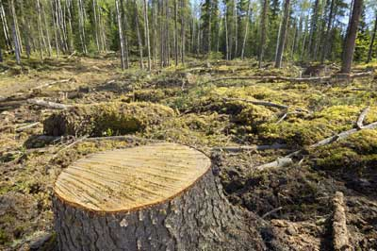
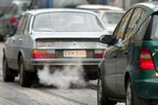
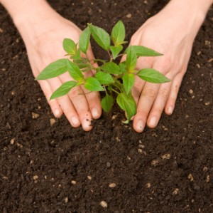
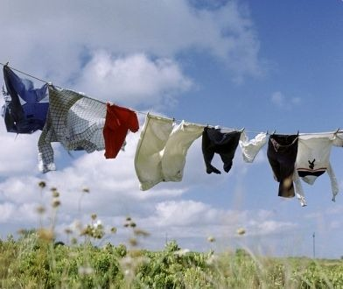
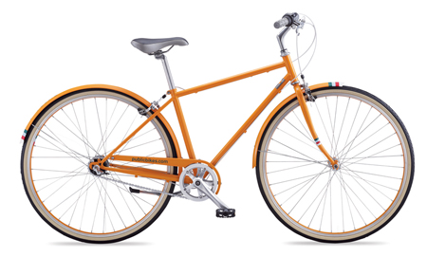
Say for the pictures which reduce global warming and say
For the pictures which increase global warming. Click on the pictures.
Burning gas
Turning light/fan off
Jute bag
Plastic bag
Using electric hair dryer
Cutting tree
Emitting carbon gas
Drying cloths in the sun
Planting tree
Using bicycle
Notes:
The pictures of this slide can help the students to understand the section B in textbook. After doing the activities of this slide it will be easy for them to do the matching of section B.

Slide 14
Individual Work/Pair Work
Now see the section B in textbook and match the sentence parts in A with those in B.
Answer
1. If I have shorter showers I will help save water at home.
2. I can help keep cars off the road by walking to school and shops.
3. When I leave a room I can save energy by turning the light off.
4. Putting on a jumper instead of the heater will keep me warm in winter.
5. Plastic bags harm wildlife, instead I can use bags made of jute or paper.
Notes:
Here the task of section B from the text book can be done. Teacher can elicit answers from 3/ 4 students. Then She/he can show the answers to compare to their answers.

Slide 15
6. I can dry my hair in the sun without using a hair dryer.
7. I can reduce, reuse, and recycle the waste I make.
8. In my garden, I should plant plants that are good for
environment.
9. When I am shopping, I should choose products with less packaging.
10. Batteries are highly toxic, if I need to use batteries I can use rechargeable ones.
Notes:
Here the task of section B from the text book can be done. Teacher can elicit answers from 3/ 4 students.

Slide 16
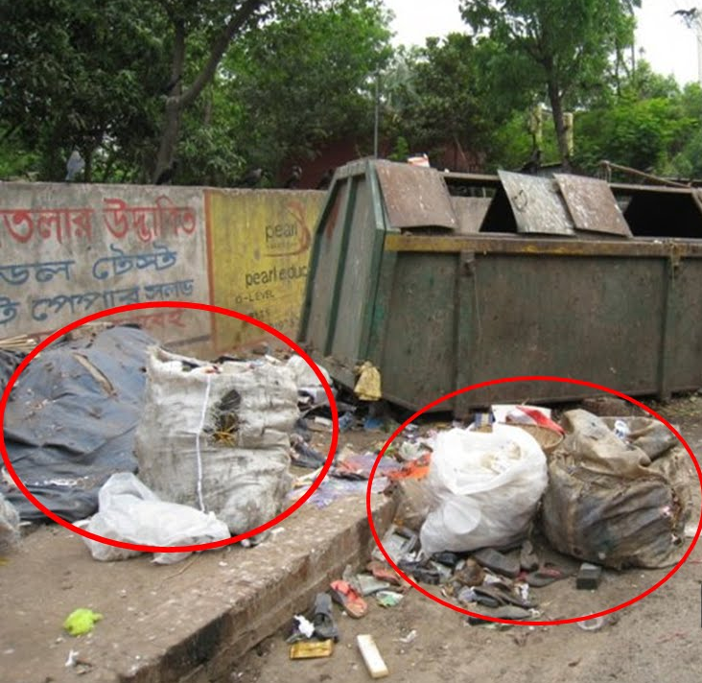
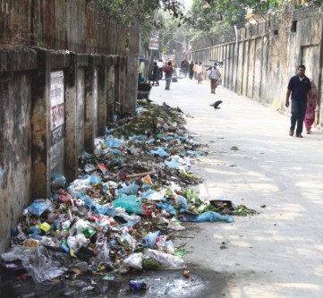
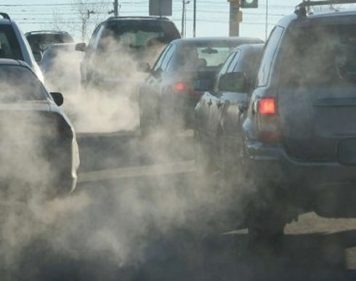
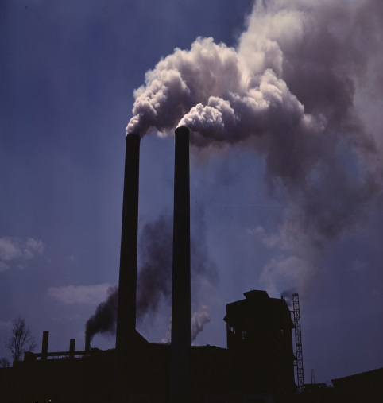
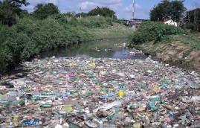
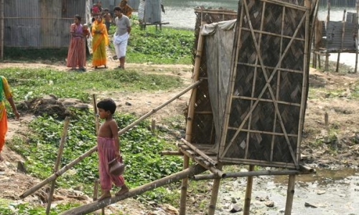
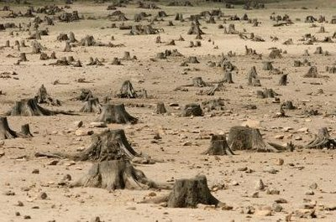
Pair Work
Look at the pictures. Discuss with your friends how the environment becomes damage.
Notes:
Teacher can give three minutes to discuss and monitor the class. She/he can help the students if they need. Then teacher can elicit answer from 2 /3 students. After this slide, if time allows, the task of section C from the text book can be done.

Slide 17
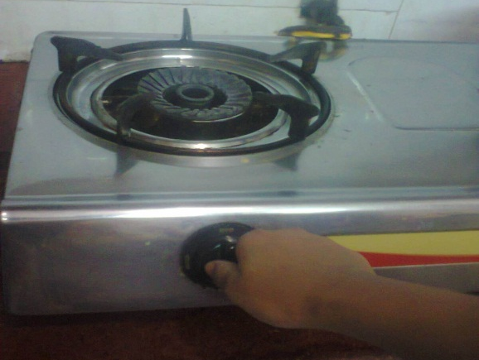
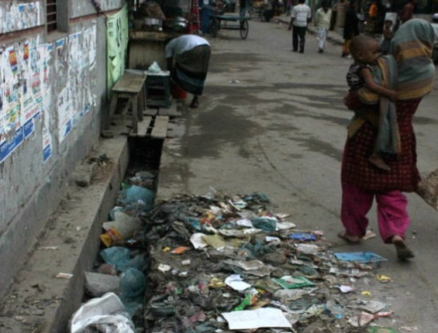
Individual Work
1. Keep the stove off when you do not need it.
1. Don’t throw wastes here and there.
Look at the pictures and two examples sentences. Now write five sentences what you can/can’t do to save the environment in your city, town or village.
Notes:
Teacher can assess 3/4 students. Teacher can ensure here that the students use imperative sentences. The purpose is to practise imperative sentence.

Slide 18
Home Work
Write a short paragraph on how to keep our environment safe and stop global warming.

Slide 19

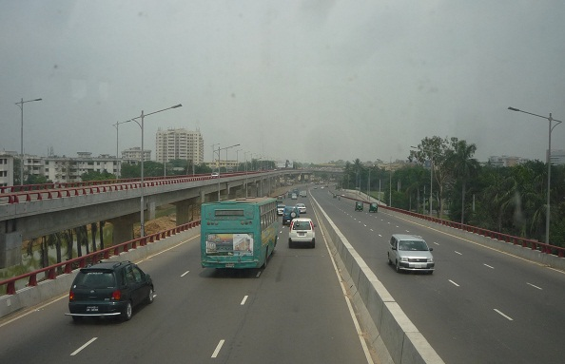
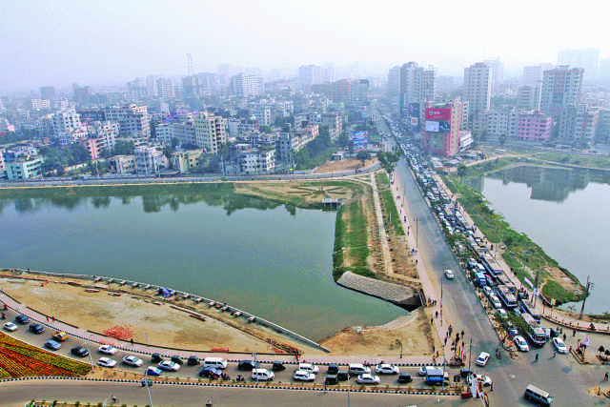
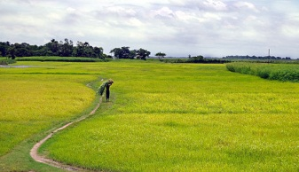

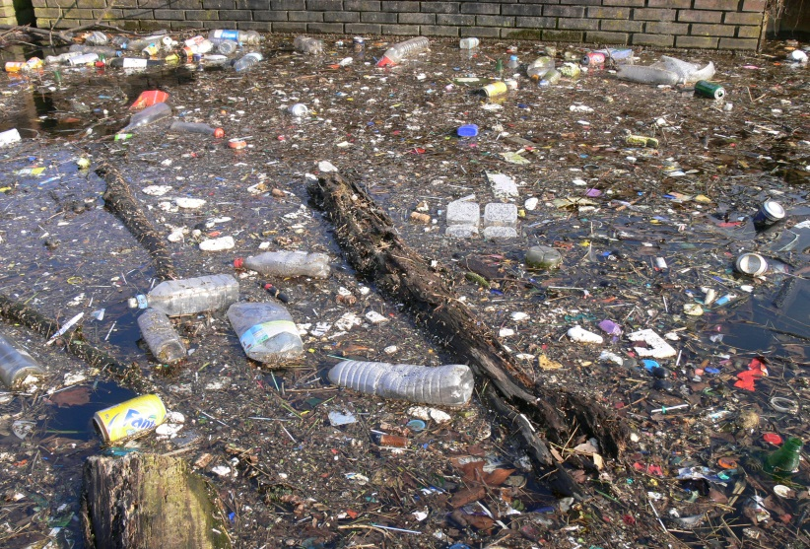
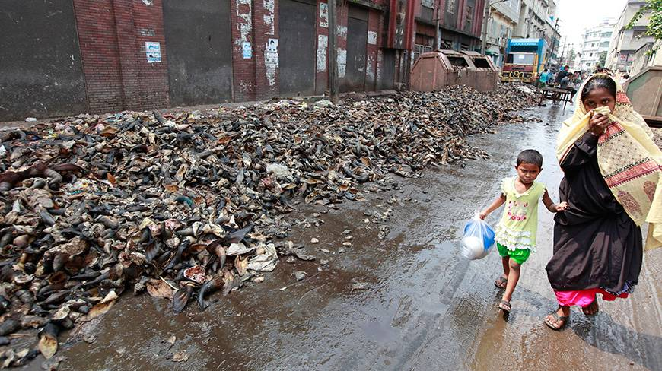
Keep the environment safe and stop global warming.
Don’t pollute the environment.
Thank you all

Slide 20
Acknowledgement
MoE, DSHE, NCTB & A2I respective of officials
And the editors panel: Ranjit Poddar, Associate Professor (English) TTC, Dhaka, Md. Jahangir Hasan (English), Assistant Professor TTC, Rangpur and Urmila Khaled Assistant Professor (English) TTC, Dhaka.
Their direction, valuable suggestions and intensive supervision have enriched the model contents.

